Slide 1
IOT COMMUNICATION PROTOCOL
SUBMITTED BY
SHRADDHA SHRESTHA
KHUSHI RANA
SPANDAN GURUNG

Slide 2
TOPICS:
Introduction
Classification
MQTT
Key concepts behind MQTT
Application of MQTT in IOT

Slide 3
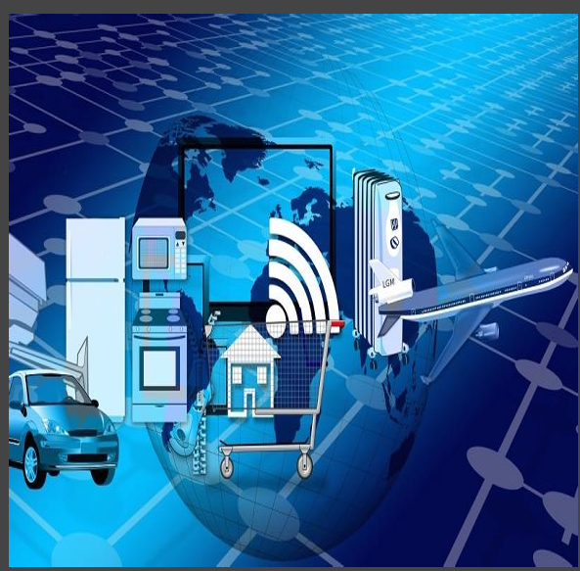
INTRODUCTION
Definition:
An IoT communication protocol a set of rules and standards that define how devices in the Internet of Things (IoT) ecosystem communicate with each other.
It defines how IOT devices communicate with each other..
Examples: MQTT, CoAP, HTTP, AMQP, etc.

Slide 4
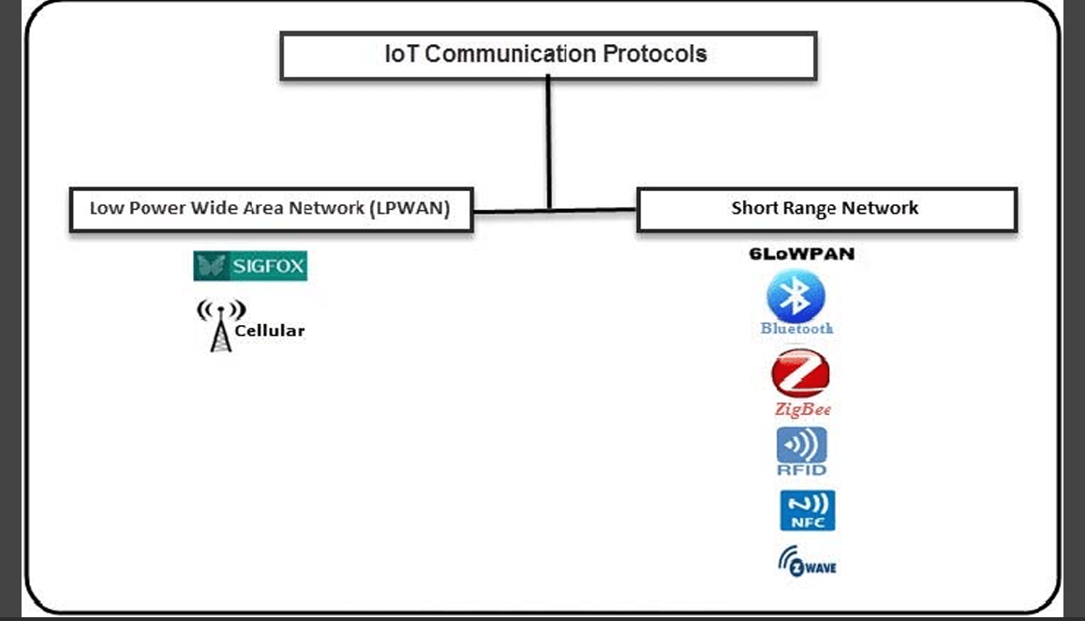
CLASSIFICATION

Slide 5
MQTT
INDRODUCTION:
Message queue Telemetry transport (MQTT).
Designed to be light weight , reliable and simple architecture , so it can work in very low bandwidth network.
Allows communication between nodes in both reliable and unreliable network.
Developed By: IBM in 1999.

Slide 6
CONTD..
KEY FEATURES:
Lightweight.
Bi-directional communication.
Security enable  Reliable and support in unreliable network.
It is designed as an extremely lightweight publish/subscribe messaging transport that is ideal for connecting remote devices with a small code footprint and minimal network bandwidth.
MQTT today is used in a wide variety of industries, such as automotive, manufacturing, telecommunications, oil and gas, etc.
MQTT follows a publish/subscribe architecture.
Meaning that there are nodes (brokers) that make the information available, while others (clients) can read the available information after subscribing by accessing the corresponding URL.

Slide 7
KEY CONCEPT BEHIND MQTT
Publisher-Subscriber Model:
MQTT follows the publisher-subscriber model, where devices (or clients) publish messages to topics and subscribe to receive messages from topics.
Publisher: A client that sends messages to a specific topic.
Subscriber: A client that receives messages from topics it is subscribed to.
Broker: A server that routes messages between publishers and subscribers. It ensures message delivery and controls subscriptions.

Slide 8
CONTD…
Topics:
In MQTT, messages are published to "topics," which are like channels or categories. Subscribers receive messages from topics they subscribe to. Topics are hierarchical and separated by slashes, like home/living room/temperature.
Quality of Service (QoS): MQTT allows messages to be delivered at different levels of reliability:
QoS0: "At most once" delivery. The message is delivered once, or not at all, with no acknowledgment.
QoS1: "At least once" delivery. The message is guaranteed to be delivered, but it may be delivered multiple times.
QoS2: "Exactly once" delivery. The message is guaranteed to be delivered only once.

Slide 9
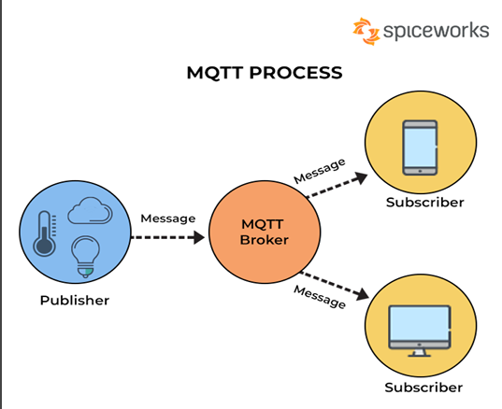
APPLICATIONS OF MQTT IN IOT
Home Automation: Smart thermostats, lighting, security systems.
Healthcare: Remote monitoring of patient data.
Industrial Automation: Sensor networks, machinery monitoring.
Transportation: Fleet tracking, vehicle telematics.
Example:
The temperature sensor publishes data:
Topic: home/room1/temperature
Message: 25°C

Slide 10
CONTD..
The MQTT broker receives the message and forwards it to all subscribers.
The smartphone app, subscribed to home/room1/temperature.

